Slide 1

Danish Strongholds in Circular Economy

Slide 2
How to Use This Presentation
Export of circular economy
This PowerPoint presentation provides an overview of Danish capacities within circular economy (CE).
Danish exports of green products and services amounted to 98 billion DKK in 2022. Most of this export is related to wind power and the green energy transition. However, while energy security and reduction of greenhouse gasses long have been in the center of attention, CE is now gaining momentum. Strategies and actions plans are developed in Denmark, EU, and from Thailand to Kenya.
In recent years, we have seen robust global supply chains breaking up due to COVID-19, we have seen geo-political tensions creating trade barriers and restrictions, and we have seen waste being mismanaged thus ending up polluting the environment. CE seek to optimize resource use and safely manage waste streams in an economical viable manner. It has the potential to merge environmental sustainability and economic prosperity.
Method
This project is based on interviews with experts for firsthand insights, 4 workshops for group discussions and brainstorming, and an extensive literature review to understand current trends and challenges in the circular economy. These methods has provided a comprehensive and practical understanding of the Danish capacities within the circular economy.
H
How to use this PowerPoint?
To use this PowerPoint, you should follow the structure of slides for each sector. This structure is divided into four parts:
Overview: This part provides a summary of the sector being discussed.
Three Key Areas: This part is further divided into knowledge, technology, and system.
Knowledge: This pertains to the specialized expertise and understanding that businesses hold, which could range from design principles to strategic innovation tactics and environmental impact assessments.
Technology: This refers to the innovative tools or technological solutions developed by businesses, helping to optimize resource usage, minimize waste and improve sustainability practices.
System: This denotes the efficient models and supply chains that businesses create and operate within, thereby facilitating the implementation of effective circular economy strategies. These can include online sales models, service-based models, and reuse systems.
Relevant Businesses: This part introduces businesses relevant to the sector being discussed Note that the list is not exhaustive.
Case: This section presents a specific case study related to the sector being discussed.

Slide 3
Contents
Introduction to Circular Economic Activities and the Danish Context
Circular Economy and Waste Management in a Danish Context
Definition
Strongholds across circular economy
Sectors
Furniture
Plastic
Construction and Demolition
Waste Management
Packaging
Textiles
Organic Waste
Digitalisation

Slide 4
Introduction to Circular Economic Activities and the Danish context

Slide 5
Circular Economy and Waste Management in a Danish context
The history of circularity in Denmark
Denmark has for decades had a tradition of a semi-linear economy with some degree of reuse and recycling of resources in the overall waste sector. The linearity has generally been based on incinerators with energy utilization for district heating purposes and some electricity. The reuse and recycling was limited to a few fractions from industries and households, together with materials utilization of bulky demolition materials like concrete.
Away from incineration
Denmark is a world leader in waste incineration and has exported the technology for many years, but with waste incineration of products and materials comes losses of resources that could have been included in a circular economy. Denmark has therefore, in line with an increasing focus on consumption and virgin resources, changed its focus towards a circular economy.
Denmark without waste
As early as 2013, the government launched the strategy “Denmark without waste”, aiming at a higher degree of circularity. This strategy contained plans for a circular economy inside various sectors, based on assessments of the actual potential, to ensure far better recirculation of products and materials. Most recently, the government published an Action Plan for Circular Economy in 2021. It contains a list of actions that will further the transition towards circularity.
Responsibilities on household waste management
Collection of household waste is under the municipal auspices. The collection is nationally harmonized through uniform rules for waste collection in 10 waste fractions and the use of pictograms. While municipalities safeguard waste management according to the waste hierarchy, the waste is tendered to private waste handlers that manages the waste. Denmark is a top achiever in effectively and responsibly managing waste: 57% of household waste is recycled, 42% is incinerated and only 1% is landfilled.
However, while households produces 3.3m tons annually in Denmark, the industry produces 9.1m tons. Companies in the industry have to follow the polluter pays principle. It ensures that companies have their waste managed by the well-coordinated waste sector. 74% of all waste is recycled and material recovered when both waste from households and the industry is included.
Circularity as a matter of design
The national regulations are a step in the direction of a higher degree of opportunity for business creation and value chain formation, as the waste sector is only part of the circular economy. However, all products in the future must be made so that they are designed for reuse and recycling, to avoid the loss of resources. Therefore, the design of products is as important as the collection of waste in a circular economy.

Slide 6
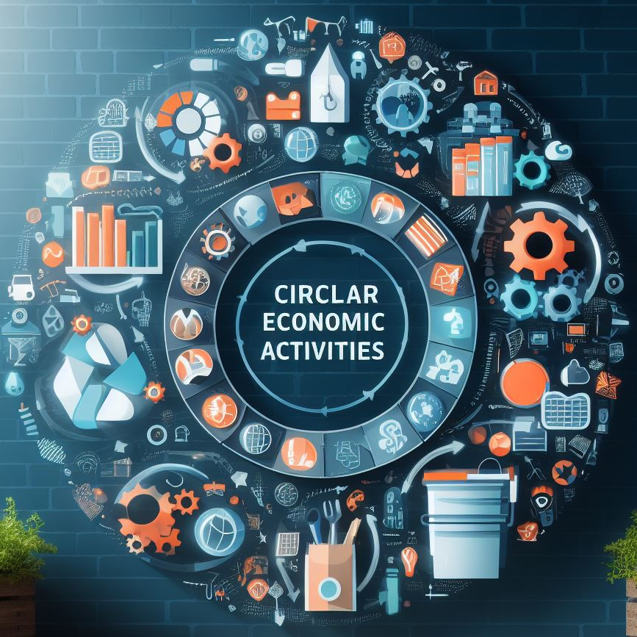
Definition on Circular Economic Activities
Circular economy
Circular economy is an economic model in which resources are used optimally. Optimal use occurs with well-designed products and by recirculating products in order to preserve value in products and prevent the extraction of virgin materials. Finely formulated by the Ellen MacArthur Foundation:
Circular economy is an economy that provides multiple value-creation mechanisms which are decoupled from the consumption of finite resources
Circular economic activities
Circular economic activities can be products and services that support circularity. These are not necessarily circular in their own right. Instead, economic activities can be characterised as contributing to a circular economy.
According to the EU Taxonomy, the concept of circular economy is broad and can thus end up being devaluated. Therefore, the EU Taxonomy prescribes that economic activities need to contribute substantially to the transition towards a circular economy to be within scope. This means including a small part of recycled materials in the production of new products, not necessarily can be seen as a circular economic activity. To help navigate this, the PowerPoint includes a broad range of economic activities that contribute to a circular economy. These activities can be products and services such as recycling technologies, rental business models, it systems, design, and life cycle analyses.
Circular economic activities are activities that contribute substantially to the transition towards a circular economy.

Slide 7
Strongholds in Denmark
Tendencies across industries
Within the sectors, there are specific focal points. At the same time, there are characteristics of the Danish business environment that are cross-cutting for the circular economy.
+ Strong Design DNA
Denmark has a strong design DNA, which especially entails quality and creative designs. Design has historically been within the construction and furniture industries, but it is increasingly seen in other sectors, such as through guides for design for plastic products. Design is crucial for creating products for the circular economy. Well-designed products are durable, can be separated after use, are repairable, reusable, and can be used in circular business models.
+ Knowledge and Consultancy
Danish consultants are uniquely positioned to assist in the transition to a circular economy, capitalizing on the knowledge Denmark has acquired in this field. They can offer strategic advice, expert guidance, and practical roadmaps, all underpinned by Denmark's experience with circular economy principles like resource efficiency.
The consultants can use their technical expertise and know-how in environmental planning to support advanced engineering in setting-up biogas power plants and waste recovery facilities. They can aid in modifying business models and value chains to better suit a circular economy, drawing lessons from the Danish experience. Additionally, Danish consultants can provide training to help staff understand and implement the principles of a circular economy.
+ System for Waste Management
Denmark's effective waste management system is the result of a well-organized structure involving the government, municipalities, and industry. The government sets regulations, municipalities handle waste collection for households while the industry processes the waste and innovates new waste treatment technologies. This high level of coordination, coupled with the commitment of the Danish population to waste sorting and recycling, enables Denmark to maintain a responsible waste management system.
÷ Export of certain waste fractions
Due to being a small country, Denmark has traditionally exported several waste fractions, particularly paper, metal, and plastic, to other countries, particularly Germany, which have more advanced waste management facilities. This was not due to a lack of effort or intent, but rather the practical realities of building a business case in a smaller market.
However, this scenario is changing. With the end of the monopoly by municipalities on waste management, an increasing number of investments in sorting facilities and recycling plants are being made. This shift towards a more self-sufficient waste management system aligns with Denmark's commitment to a circular economy. While Denmark may not be a major production powerhouse, it is home to companies that specialize in producing waste processing equipment, further contributing to its role in the circular economy.

Slide 8
Sectors

Slide 9
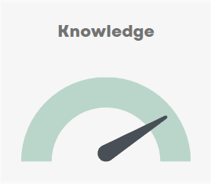
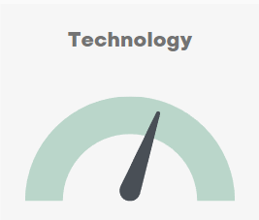
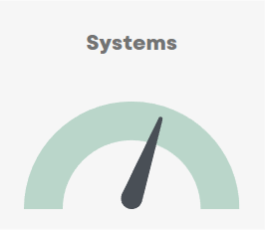
Furniture

Slide 10
Furniture
Furniture in the circular economy
In the 20th century, Danish furniture design became a significant economic force. Designers like Arne Jacobsen, Hans Wegner, and Finn Juhl propelled Danish furniture onto the global stage, driving substantial exports. The iconic Danish Modern aesthetic, characterized by clean lines and ergonomic functionality, created a strong market demand. Danish furniture companies, such as Fritz Hansen and Carl Hansen & Søn, capitalized on this success, contributing significantly to Denmark's economy through exports and job creation.
In the 21st century, a lot of Danish furniture has continued to have a high standard. Factors like durability has become a highly sought-after quality in the furniture industry, representing a significant competitive advantage. Warranties, spanning from 5 to an impressive 25 years, underscore this commitment to long-lasting quality. Danish furniture brands have sustained close links with production facilities, ensuring close coordination for design and quality. The focus on creating durable, timeless designs with sustainable materials positions Danish furniture as a viable solution for the circular economy. The industry's embrace of repair services, remanufacturing, and recycling further extends product lifespans and minimizes waste, fostering a more circular and economically sustainable approach.
Drivers for a possible market
Regulation is a strong driver for CE on the EU market. Particularly, Ecodesign for Sustainable Products Regulation and Green Claims create a demand for new solutions and a possible market for Danish companies. They include eco-design for products (such as durability, reparability, and recyclability) and truthful environmental advertising.
On international markets Danish brands are positioned in the higher-value segments. The products are targeted consumers that are conscious of quality and sustainability. Additionally, the effects of the new EU requirements may trickle down in various forms. Particularly, furniture producers will need to live up to new reporting schemes, e.g. documenting environmental performance.
Characteristics of the Danish furniture industry
The Danish furniture industry has for decades been internationally recognized brand. The characteristics are:
Craftsmanship & Durability: Danish brands are known for their high-quality and durable furniture that comes from exceptional craftsmanship.
Design Innovation: Danish designers create timeless, functional pieces with a minimalist aesthetic.
Functionality: The furniture is user-friendly, with a strong emphasis on practicality and usability.

Slide 11
Knowledge
Technology
Systems
Design – from cradle to cradle
Danish design has historically excelled in various fields, including furniture design, architecture, textiles, and graphic design. Characteristics of Danish design include simplicity, high quality, and craftsmanship.
The Danish furniture industry is well-versed in sustainable practices, with expertise in using eco-friendly materials and techniques. It also incorporates circular economy principles, managing products from creation to disposal, effectively minimizing waste and maximizing value, demonstrating a practical application of circular business models
Life Cycle Assessment
Several Danish consulting firms have specialized in making Life Cycle Assessment (LCA). One consultant is developing user-friendly Life Cycle Assessment (LCA) tool that can be used within the reporting regime that the EU is establishing during these years. There is already demand for this service, and it is expected to grow.
Resale
Danish furniture is made for resale as it is physically as well as emotionally durable. Resale is often made C2C through online platforms. However, many companies also take back their products for reparation and to be shined up. The products can then be sold again for a new life.
Product as a service
Companies provide furniture services to public institutions. For instance, schools buy the service of having rooms furnished on subscription. The company provides chairs, desks, and sofas which are repaired or replaced over time.
Reuse (NGOs)
In Denmark, NGOs collect used furniture from various sources and sell them in their second-hand stores. This not only promotes sustainability by reducing waste, but also provides an affordable furniture option for people. The proceeds are then used to fund the NGOs' social and charity projects.

Slide 12
Knowledge
Technology
Systems
Design – from cradle to cradle
Holmris
Frits Hansen
Montana
Takt
Gabriel
Mater
Wehlers
Life Cycle Assessment
Målbar
Resale
Holmris
Product as a service
Høyer Møbler
Holmris
Reuse (NGOs)
Red Cross
UFF Humana
Danmission
Frelsens Hær
Blå Kors

Slide 13
Case - Maalbar
Business Case: MÅLBAR Tool for industrial designed products
Objective: To utilize the MÅLBAR screening tool to measure and reduce the environmental impact of furniture products, ensuring compliance with EU regulations and enhancing efforts for the green transition.
Situation Analysis: The furniture industry is increasingly facing stringent environmental regulations aimed at reducing carbon emissions and promoting sustainability. Key regulatory developments include the EU’s Corporate Sustainability Reporting Directive (CSRD), and the upcoming Ecodesign for Sustainable Products Regulation (ESPR). Additionally, the new Green Claims Directive requires companies to substantiate environmental claims with verifiable data, for instance through the use of Product Environmental Footprint (PEF) standards.
Solution: The MÅLBAR tool provides a comprehensive solution for measuring the climate and environmental impact of furniture products. It aligns PEF standards and helps companies comply with reporting for CSRD. The tool facilitates data collection, analysis, and reporting, enabling companies to take informed actions to reduce their footprint.
Key Features of MÅLBAR Tool:
Data Collection: Easy collection of data across the entire value chain.
Analysis: Detailed analysis of the product’s environmental impact.
Reporting: Generation of reports that comply with international standards and frameworks.
Compliance: Helps in meeting EU sustainability regulations and reporting requirements.
Implementation Example:
TAKT: This Danish furniture company uses the MÅLBAR tool to calculate the product environmental footprint for each of their products, adhering to the EU’s rules for Product Environmental Footprint (PEF). TAKT employs both self-assessments and third-party verified screenings to ensure the accuracy and reliability of their sustainability claims. This approach helps TAKT identify key areas for improvement, implement strategies to reduce their footprint, and communicate their environmental impact transparently to customers​.
Benefits:
Environmental Impact: Reduction in carbon emissions and overall environmental footprint.
Regulatory Compliance: Ensures adherence to EU regulations and standards.
Market Differentiation: Enhances the company’s reputation as a brand pushing for the green transition.
Cost Efficiency: Identifies cost-saving opportunities through improved resource efficiency and waste reduction.
Investment: The initial investment involves the cost of integrating the MÅLBAR tool into the company’s existing systems and training staff to use the tool effectively.
Return on Investment: The ROI is seen in reduced environmental impact, compliance with regulations, improved brand image, and potential cost savings through optimized resource use and waste management.

Slide 14
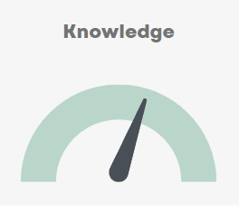
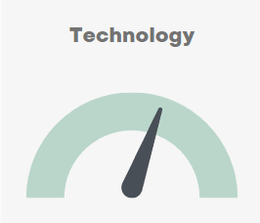
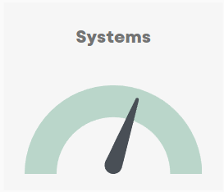
Plastic

Slide 15
Plastic
Plastic in the circular economy
Plastics, due to their low production costs and inherent versatility, play a significant role in the circular economy. This material can easily be molded, hardened, and reshaped, making it ideal for a wide range of applications, from packaging to automotive parts. However, global production of plastic is increasing at an unsustainable rate – there is too much unnecessary plastic and too much plastic waste ends up being mismanaged. In Denmark there is a robust plastic industry that is now transitioning towards more sustainable practices. Coupled with Denmark's advanced waste management systems, the plastic industry is evolving to reuse and recycle more. Yet, as with textile, virgin plastic is so cheap that it weakens the profitability of recycling.
Drivers for a possible market
Regulation is a strong driver for CE on the EU market. EU regulation, such as the Single-Use Plastics Directive and the Packaging, Packaging Waste Regulation and Ecodesign for Sustainable Products Regulation, increases demand for sustainable practices like designing plastic products for recycling, meeting targets for waste reduction, and establishing systems for the reuse and refill of packaging materials.
Beyond the direct regulation, the producers increasingly see environmentally friendly designs as a market opportunity, using recycled materials and ensuring their products can be recycled post-use.
Globally, most plastics can be recycled if it is separately sorted, but still ends up polluting the land and marine environment. Plastic waste is an area of concern with high national and international visibility, paving the way for UN negotiations on a global plastic treaty that aims to limit unsustainable consumption of plastics, and increase demand for sustainable production, use and recycling.
Characteristics of the Danish plastic industry
The Danish plastic industry is characterized by:
Proper Waste Management: In Denmark, there is a strong system to ensure that plastic waste is collected and managed properly to secure that no waste ends up in the environment.
Use of Design Guide: A united Danish plastic industry has developed a design guide as a common reference tool on circular economy for plastic packaging. It includes knowledge and practical information on circular strategies and design that foster waste prevention, reuse and recycling.
Innovation and Adaptability: Danish plastic companies incorporate recycled plastics into product design, proactively adapting to sustainability-focused technologies and guidelines.

Slide 16
Knowledge
Technology
Systems
Packaging manufacture
The packaging manufacturers adhere to circular design criteria, for instance producing plastic products with monomaterials that can be recycled. They have a universal understanding of circular economy principles across the organization doesn't just enable the creation of circular products, but also strengthens their marketability. With everyone from production to sales comprehending the importance and benefits of these products, they are better equipped to communicate this value to customers.
Consumer products
Producers of consumer products have a proactive and innovative approach to circular economy. One of the intriguing practices being experimented with is the take-back systems. This approach is based on insights gained from products that have been previously put on the market. Also, instead of holding onto proprietary practices, companies are opening their doors and sharing their methods and techniques.
Recycling
While, there are recycling of some plastic types in Denmark, most post-consumer plastic is sorted in Germany. Still, Denmark holds an array of smaller plastic recyclers and a few larger. Some have focus on ensuring plastic litter, such as fish nets are collected and recycled. Other larger Danish brands have specialised in recycling of tires and synthetic turfs. Both outputs can be recycled into new synthetic turfs.
Collection of waste at the source
Plastic is a separate fraction in the waste collection and treatment system. Through out the comprehensive and efficient collection system the Danish waste collection system is a key player in the waste management. Collection of waste from households is effective and under constant development to secure high level of performance in the recycling of plastic materials.
Pre-consumer recycling is another stream of plastic with high level of recycling and high level of quality of the recycled material. Most companies with production of plastic items reload the cut off materials into the material stream to secure the material losses as low as possible. This is done internally on site or through the raw material companies.

Slide 17
Knowledge
Technology
Systems
Packaging manufacture
Faerch
Plus Pack
Schoeller Plast
Trio World
AVK Plast
MV Plast ApS
Letbek Plast
BEWI
Consumer products
Novonesis
Novo Nordisk
LEGO
Coloplast
Grundfos
Danfoss
Recycling
Aage Vestergaard Larsen
Elysium Nordic
Damifo
Ragn-sells
RC plast
Trebo
A.V.Pehrsson A/S
Dansk Affaldsminimering
Genplast
Plastix
SmallREvolution
MangaStreet
Genan
Re-Match
Collection of waste at the source
See waste management companies in the section on waste management
Recycling of pre-comsumer waste
See among others packaging manufactures

Slide 18

Case - Plastix
Business Case
Exporting Danish Recycling Solutions to Enhance Circular Economy in the Automotive Industry
Objective
To implement Plastix's innovative recycling solution to support the sustainability goals of the global automotive industry, thereby promoting a circular economy.
Situation Analysis
The automotive industry is under increasing pressure to reduce its environmental impact. One area of focus is the materials used in car manufacturing, including plastics. The BMW Group, for example, aims to use thermoplastics made from 40% recycled material in its new vehicles by 2030.
Solution
Plastix has developed a recycling process that turns waste material from the maritime industry, like fishing nets and ropes, into plastic granules suitable for car manufacturing. These granules can be used in the injection moulding process to produce trim parts for both the exterior and interior of vehicles. The BMW Group has already started to use these recycled materials in some of its models.
Benefits
Environmental Impact: The use of recycled materials helps to reduce CO2 emissions by 25% compared to conventionally manufactured components.
Resource Conservation: The recycling process reduces the need for petroleum-based primary plastics.
Ocean Pollution Reduction: By recycling waste from the maritime industry, ocean pollution is mitigated.
Export Opportunities: The successful implementation of Plastix's recycling solution in the automotive industry can pave the way for further export opportunities of Danish recycling solutions to other industries.
Investment
The investment required would be the cost of developing and implementing Plastix's recycling solution in the automotive industry, including customization costs, training, and ongoing support.
Return on Investment
The return on investment would be seen in the reduced environmental impact of the automotive industry, the conservation of resources, the reduction of ocean pollution, and the potential for future export opportunities.

Slide 19
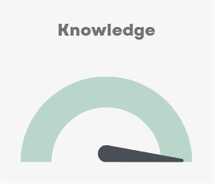
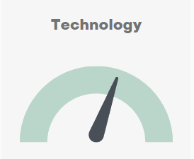
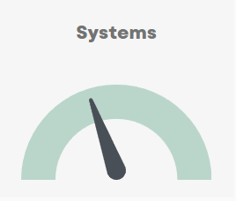
Contruction & Demolition

Slide 20
Construction and Demolition
Construction and Demolition within the Circular Economy
Construction and demolition waste account for 38% of waste generated in the EU, with a substantial amount of materials ending up in landfills. There are significant challenges to overcome, such as regulatory barriers, a lack of knowledge and skills in circular design, and the need for a market that values reused and recycled materials. The shift towards a circular economy in construction also requires a paradigm shift in how buildings are designed, constructed, and deconstructed.
Yet, the potential environmental and economic benefits are substantial if this transition can be achieved. The Danish construction industry recycles about 86% of its building waste, significantly higher than the EU average of approx. 50%. The Danish sector stands out in this context, renowned for its trust-based society, commitment to quality and craftsmanship, and potential for circular design. These factors, combined with its extensive experience with circular economy practices, efficient coordination, and advanced digitalization, contribute to the industry's robustness
Drivers for a possible market
Direct regulation and a strong attention on sustainability by major cities and developers are driving the EU market for circular solutions in the construction and demolition sector.
EU's Construction Products Regulation and the EU Taxonomy provide clear definitions of environmentally sustainable economic activities, guiding investments towards green projects and preventing greenwashing. Cities are also driving market demand by setting ambitious net-zero strategies. Buildings built in the urban area can be required to ensure minimize greenhouse gas emissions across the site, minimize the generation of waste, and maximize reuse and recycling. Meanwhile, cities have big purchasing power and can in their public procurement create a market for circular solutions.
Characteristics of the Danish Construction and Demolition Industry
The Danish construction and demolition sector in the circular economy is characterized by:
Project Management: The Danish construction and demolition industry stands out for its exceptional project management capabilities. The industry efficiently coordinates various stakeholders involved in a building project, ensuring smooth execution of projects while upholding sustainability guidelines.
Collaborative approach: Denmark's culture of cooperation, backed by a trust-based society, plays a crucial role in the building and construction industry. This collaborative environment ensures efficient coordination among stakeholders, facilitating the successful implementation of complex projects adhering to circular economy principles.
Data Utilization: Denmark leads in digitalization, supporting circular economy business models with data on materials, products, supply chains, and systems.

Slide 21
Knowledge
Technology
Systems
Circular design (architects)
Danish architecture firms have in-depth knowledge of circular building strategies and designs. This expertise enables them to facilitate the reuse and recycling of building materials and components, contributing significantly to the promotion of circular economy principles in the construction and demolition sector.
Circular design (consultants)
Danish consultancies aid the construction and demolition sector by advising on circular economy principles. They guide companies on reducing waste and recycling materials, as well as designing buildings for efficient deconstruction. In addition, these consultancies navigate regulatory requirements and help create business models that optimize economic benefits from circularity.
Circular production
Several companies that produce materials for the building and construction sector are focused on producing more reusable and recyclable products. Meanwhile, they are increasing focused on business models where materials are reused and recycled.
Digital tools
The Danish construction and demolition sector is recognized for its proficient use of digital tools in the circular economy. Tools such as material passports and digital product tracking are instrumental in managing resources effectively and fostering transparency in material usage.
Reuse
In Denmark, one company has developed a cleaning-technology and uses it to prepare old bricks for reuse. Another has specialized in business models with rental of equipment, from small tools to large machinery.
Demolition
In Denmark, there are high standards for demolition of buildings. It means firms have specialised in using building materials as resources by developing technologies for scanning the materials for hazardous chemicals and reusability. Further, the industry is further specialised in recycling concrete and plaster.
Reuse on online platforms
Albeit still rather new, Danish firms have developed online platforms that facilitates the sale of surplus and recycled building materials. It acts as a conduit between various stakeholders, making it easier to buy and sell used materials.

Slide 22
Knowledge
Technology
Systems
Circular design (architects)
Lendager
3XN
Vandkunsten
SLA
Circular Design (consultants)
COWI
Ramboll
Niras
Production
Rockwool
Velux
Kalk A/S
Digital tools
LCAbyg (Værktøj udviklet af BUILD)
Reuse
Gamle Mursten
GSV
Demolition
Norecco
J. Jensen
Novopan
Reuse on online platforms
Circle Bank
GreenDozer
Genbyg
JK-Genbrugscenter
For flere virksomheder, se ”Frontløberne i cirkulært byggeri”

Slide 23

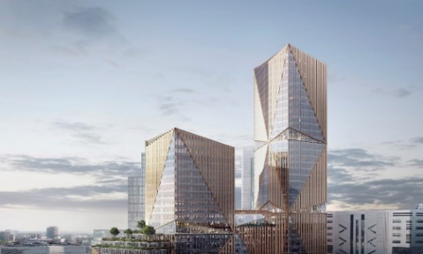
Case – 3XN GXN
Business Case
Leveraging Danish Architectural Expertise to Meet London's Circular Economy Policies in Construction
Objective
To utilize 3XN/GXN's innovative architecture, design, and consultancy solutions, a Danish stronghold in sustainable and circular design, to meet London's Circular Economy Statements and create a sustainable and futureproofed building in London's Broadgate Campus.
Situation Analysis
Greater London Authority's (GLA)'s Circular Economy Statements require new buildings to be designed with circular economy principles at the heart. These principles prioritize the retention of materials at their highest value for as long as possible, reducing waste and promoting adaptability and sustainability. This policy applies to the largest developments in London, creating a demand for innovative building designs that meet these requirements.
Solution
3XN, a Danish architecture firm, along with its sustainability and innovation consultancy GXN, have been approved to provide the design for the 2 Finsbury Avenue project in London. The project is designed with circular economy principles in mind, and will be one of the first to comply with London's new circular economy policy. It is targeting BREEAM Outstanding and is designed to accommodate WELL standards. Alongside 2FA project design work, GXN have been working with the client to develop portfolio wide strategies for circular economy, embodied carbon, and material passports.
Benefits
Environmental Impact: The project is a Net Zero Carbon development, significantly reducing operation and embodied carbon.
Circular Economy: The design implements circular economy solutions across the project, focusing on both upcycling and adaptable design. This aligns with London's Circular Economy Statements
Health and Wellbeing: The building design incorporates a range of amenity spaces and is designed based on the latest in behavioural and social science, aiming to enhance the user's experience and wellbeing.
Export Opportunities: The successful implementation of 3XN/GXN's design in London can pave the way for further export opportunities of Danish architecture, design, and consultancy solutions to other countries
Investment
The investment required would be the cost of developing and implementing 3XN/GXN's design, including costs related to planning, construction, and ongoing support as well as additional costing for strategic portfolio level consultancy.
Return on Investment
The return on investment would be seen in the environmental impact of the building, the promotion of a circular economy, the enhancement of user wellbeing, and the potential for future export opportunities

Slide 24
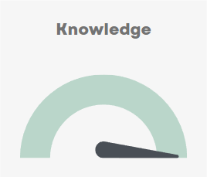
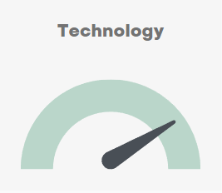
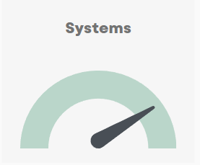
Waste management

Slide 25
Waste Management
Waste Management in the Circular Economy
Waste management is a pivotal component of the circular economy, especially considering that 2.1 billion tons of municipal solid waste are produced globally every year, with a concerning 33% of that not managed in an environmentally safe manner. Denmark, however, has made commendable strides in this area, with only 1% of waste ending up in landfills, a figure significantly lower than the EU average of 24%. The waste management sector comprises various stakeholders, such as municipal authorities, waste collectors, recycling facilities, and waste-to-energy plants, all working towards the common goal of managing waste in a way that safeguards both human health and the environment. However, the economic viability of recycling remains a contentious issue. Despite its environmental benefits over landfilling and incineration, the cost of recycling, driven by expenses in collection, sorting, and processing, often surpasses that of using virgin materials. The successful operation of the Danish waste management system owes much to the effective collaboration between the government, municipalities, and industry. This synergy has resulted in a remarkable shift towards a more circular economy model, making Denmark a leading figure in this sector.
Drivers for a possible market
EU member states have actively managed waste for decades. However, in the east and south of Europe, much waste is landfilled instead of being incinerated or recycled, as the case mostly is in the North and West of Europe. The European Green Deal and the subsequent Circular Economy Action Plan are ambitiously pushing a transition towards circularity of waste management as well as product design, promoting waste sorting, reuse and recycling, as new markets for secondary resources, and new product designs.
Municipal solid waste generation is strongly correlated with national income. As economies continue to grow rapidly in especially middle-income countries, waste generation per capita will increase steadily, putting pressure on current unsustainable practices, and create a market for sustainable infrastructure and waste management systems. Willingness to pay for effective solutions in urbanized areas, are often running ahead of political will to take the relevant decisions, such as prioritizing investments, consumer funding and organizational reforms.
Characteristics of Danish Waste Management Industry
Comprehensive Coordination: Danish municipalities have been organizing waste management for several decades, resulting in extensive knowledge and experience. The private sector, including consultants, waste handling companies, and technology providers, further support these efforts.
Focus on Sustainability: The Danish municipalities and private sector continuously strive for sustainability and circular economy goals. They work together to develop an efficient waste sector with a high degree of recycling and resource utilization.
Efficient Waste Treatment: Denmark is renowned for its waste treatment with a high level of energy production from waste-to-energy plants – which is waste management but not circular economy. In Denmark, residuals from these plants are also effectively used.
Advanced Data Collection: Denmark boasts a well-developed digital Waste Data System (ADS), which forms the foundation of its waste management and circular economy. This system provides comprehensive data that is instrumental in strategic planning and decision-making.

Slide 26
Knowledge
Technology
Systems
Consultancy
Several engineering consultancies provide a wide array of services related to the design, planning, and implementation of technical and infrastructural projects. Their work often encompasses sectors such as waste management, water and sanitation, environmental engineering, and sustainable urban development.
Other consultancies focus on providing strategic advice, policy guidance, and actionable insights to help organizations achieve their sustainability goals. This include services in behavioral change strategies to promote sustainable practices as well as development and implementation of holistic sustainability strategies.
Equipment Providers
Danish waste management equipment providers lead the global industry by delivering cutting-edge solutions for efficient waste handling. Specializing in advanced sorting machinery, recycling equipment, and streamlined waste processing systems, these firms are sought after internationally for their precision engineering and operational reliability.
Robot Technology
A cluster of Danish firms are in the forefront of robot technology globally. Intelligent robots can improve the efficiency and accuracy of waste sorting, leading to a higher percentage of waste being recycled and reused, rather than incinerated. Furthermore, automated robots capacity for continuous learning allows them to adapt to future changes in waste streams.
Planning and organization
The municipal responsibility for the handling of Danish household waste has given the Danish municipalities a unique position. The comprehensive planning of waste management has led to formation of a complex administrative and operational organization, from which concrete experiences can be drawn in many ways.
Waste Data
Denmark's advanced digital Waste Data System (ADS) is a cornerstone of its waste management and circular economy. This comprehensive data system, with its strategic planning and decision-making capabilities, could be instrumental to countries worldwide seeking to enhance their waste management strategies and adopt circular economy principles.

Slide 27
Knowledge
Technology
Systems
Consultancy (engineering)
Rambøll
COWI
NIRAS
Consultancy (strategy and advisory)
Behave Green
Norion
Sustainia
Equipment Providers
Eldan
Anker Andersen
Wamatech
Bramidan
Miltek
Gemidan
Simatek Bulk
WASTECONTROL
MJ Recycling
JOCA
ReTec Rubæk
Robot Technology
Teknologisk Institut Robotteknologi
BILA
Planning and organization
Remondis
Verdis (Urbaser)
Ragn-Sells Danmark
Stena Recycling
Uniscrap
Marius Pedersen
Meldgaard
Combineering
HCS
Citycontainer
Avista
HJHansen
Fortum Waste Solutions
Waste Data
WasteDataSystem

Slide 28

Case – Rambøll
Business Case
Maximizing Waste and Water Management through Singapore's Integrated Waste Management Facility (IWMF)
Objective
To utilize Ramboll's expertise in waste-to-energy facilities, a Danish stronghold in sustainable design, to assist Singapore in meeting its Zero Waste Nation ambitions by 2030 through the construction of the IWMF.
Situation Analysis
Singapore, with its high population density, faces challenges in waste management as most waste ends up in landfills. Singapore's goal is to become a Zero Waste Nation with a recycling percentage of 70% by 2030. The IWMF is a key facility to meet these goals, with the capacity to process more than 2.5 million tonnes of solid waste annually, which is five times the capacity of the largest European waste-to-energy facilities.
Solution
Ramboll, a Danish architecture, engineering, and consultancy company, has been appointed to conceptually design the IWMF. The IWMF will consist of a waste-to-energy facility and a sludge incineration plant. In addition, the IWMF will handle food waste and separate recyclable waste at a material recovery facility. Ramboll is the project’s technical advisor, providing owner’s engineering services.
The facility also needs to be designed to work well with the nearby water reclamation plant. The goal is for the two facilities to share resources and operate efficiently, reducing waste and saving energy, while fitting into the limited space available.
Benefits
Optimize Land Use: The innovative layout and design of the IWMF will maximize the use of limited space available.
Maximize Energy and Resource Recovery: The IWMF is designed for higher energy and resource recovery efficiencies. It will generate more electricity and recover more materials for recycling.
Minimize Environmental Impact: The IWMF will be equipped with advanced technologies to ensure clean air emissions and minimize solid residues for disposal.
Co-Location Synergies: The co-location of the IWMF with the Tuas Water Reclamation Plant will derive various process and non-process synergies to achieve higher plant performances and optimize land use.
Investment
The investment required would be the cost of developing and implementing Ramboll's design, including costs related to planning, construction, and ongoing support.
Return on Investment
The return on investment would be seen in the efficient use of land, the maximization of energy and resource recovery, the reduction in environmental impact, and the success of Singapore's goal to become a Zero Waste Nation.

Slide 29
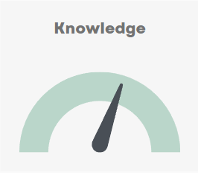
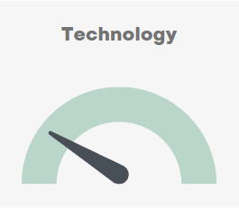
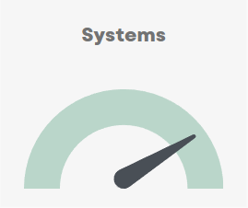
Packaging

Slide 30
Packaging
Packaging in the circular economy
Packaging plays a pivotal role in the circular economy, serving not only as a protective barrier for products but also as a key factor in waste generation and resource optimization. The impact of packaging extends beyond its primary function, influencing waste management systems, resource allocation, and consumer behavior. As such, the transition from traditional, often single-use packaging to more sustainable, circular models is increasingly vital.
Denmark's packaging industry is at the forefront of this shift, demonstrating a strong commitment to innovation and sustainability. Through the development of recyclable and biodegradable packaging materials, integration of efficient design principles, and implementation of advanced waste management practices, the Danish packaging industry is driving the shift from a linear model, where packaging is used and discarded, to a more circular model, where packaging materials are continually reused and recycled. This transformation within the industry not only reduces environmental impact but also paves the way for new opportunities in the global packaging market.
Drivers for a possible market
In the EU, around 40% of plastics and 50% of paper are used for packaging. Regulation on packaging and packaging waste push towards less packaging, recyclable packaging and more reuse of packaging. For instance, new regulation requires member states to develop deposit schemes, achieve reduction targets on packaging waste, restrict over-packaging, and make all packaging recyclable.
Internationally the attention to packaging is mostly driven by visible plastic pollution. Particularly, the policy tool extended producer responsibility is seen as a central tool to manage packaging waste by establishing an organizational framework and a system for financialization.
Characteristics of the Danish Packaging Sector
Innovative Design: Danish packaging firms are well-regarded for their inventive and practical designs, which often incorporate eco-friendly materials and promote ease of reuse or recycling.
Reusable Packaging Design: Several Danish firms are at the forefront of creating reusable packaging solutions. These designs significantly reduce waste and promote a shift from single-use to reusable packaging.
Material Efficiency: The industry is highly conscious about material usage, striving to minimize waste and optimize resources. This is reflected in the choice of recyclable or biodegradable materials in packaging.
Advanced Waste Management: Denmark's systematic segregation and collection of packaging waste leads to a higher quality of recyclable materials, thereby promoting their reuse.
Regulatory Compliance: Danish packaging companies are responsive to EU's packaging regulations, demonstrating their commitment to sustainability and adherence to international standards.

Slide 31
Knowledge
Technology
Systems
Design
Danish design is a key factor in promoting reuse and recycling in the packaging industry. With a strong focus on sustainability, Danish businesses are committed to creating packaging that is not only visually appealing but also designed to minimize waste and encourage circular practices. They incorporate features that facilitate easy reuse or efficient recycling, reflecting a commitment to environmental responsibility. This approach not only reduces the environmental impact but also aligns with the growing consumer demand for sustainable packaging solutions.
Digital tools
Technology plays a pivotal role in enabling the reuse of packaging in a closed-loop system. The integration of technology allows packaging to be tracked throughout its lifecycle, ensuring its return and reuse. This digital approach not only facilitates the reuse process but also provides valuable data on environmental impact and enhances consumer engagement.
Reuse systems
Digital return systems for takeaway packaging are gaining traction, with reusable food containers and coffee cups provided as sustainable alternatives to disposable packaging. These systems not only reduce waste, but also offer economic benefits to businesses, as reusable packaging proves to be a more cost-effective solution in the long run.
Deposit system
The Danish deposit system is acclaimed for its effectiveness in promoting a circular economy, which means that resources are reused and recycled to the greatest extent possible. The system achieved a return rate of 92% in 2022, a figure that's among the highest in the world. The system's operation costs are offset by the revenue generated from recycling, which has allowed the system to operate with a zero fee for single-use packaging. Moreover, the Danish deposit system is on a path towards becoming 100% circular, an ambition supported by a continued focus on operational efficiency and optimization.

Slide 32
Knowledge
Technology
Systems
Design
Plus Pack
Paboco
Hartmann Packaging
KLS Pure Print
Biobag Zenzo
Novo Nordisk
Digital tools
See companies under ‘systems’ as most have developed digital tools to support their circular systems.
Reuse systems
RE-ZIP
RePack
New Loop
Kleen Hub
Cirqle
Genkrus
Deposit system
Dansk Retursystem
Tivoli
TOMRA

Slide 33

Case – Dansk Retursystem
Business Case
The Danish Deposit System: Dansk Retursystem as a Showcase for Circular Economy
Objective
To showcase the effectiveness of Dansk Retursystem in driving circular economy practices within Denmark by efficiently managing the deposit-return system for beverage containers.
Situation
Analysis Denmark has one of the world's highest return rates for beverage containers, with more than 90% of sold containers getting returned for recycling. This achievement is largely due to the efficient management of the deposit-return system by Dansk Retursystem, a non-profit organization owned by the Danish breweries.
Solution
Dansk Retursystem operates the Danish deposit system, ensuring that single-use beverage containers made of plastic, aluminum, and glass are recycled. The organization manages the entire life cycle of the containers, from the point of sale to return, and finally, to recycling.
The operation of Dansk Retursystem is politically regulated by a decree to the Environmental Protection Act. The decree specifies which beverages and containers producers must put a deposit on, who is obliged to accept consumers' empty bottles and cans, and how Dansk Retursystem should manage the work.
Benefits
Environmental Impact: By ensuring the recycling of beverage containers, Dansk Retursystem helps to reduce waste, conserve natural resources, and reduce CO2 emissions.
Economic Efficiency: Dansk Retursystem operates as a non-profit organization. Its income comes from the sale of recyclable materials, fees paid by manufacturers and importers for putting a container with a deposit into the market, and from unclaimed deposits. This ensures the system's financial sustainability and affordability for all stakeholders.
High Return Rates: Dansk Retursystem's efficient operations have resulted in a return rate of over 90% for beverage containers, one of the highest in the world. This high return rate is a testament to the effectiveness of the system in motivating consumers to return their beverage containers for recycling.
Investment
The operational costs of Dansk Retursystem are covered by the income from the sale of recyclable materials, fees paid by manufacturers and importers, and unclaimed deposits. Any investments needed for system improvement or expansion are also funded from these sources.
Return on Investment
The return on investment is seen in the environmental benefits of reduced waste and lower CO2 emissions, the economic benefits of resource conservation, and the social benefits of a cleaner and more sustainable environment.

Slide 34
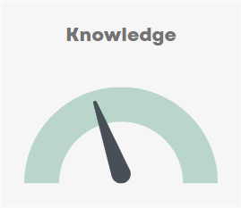
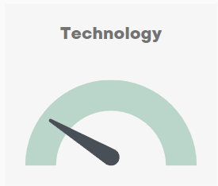
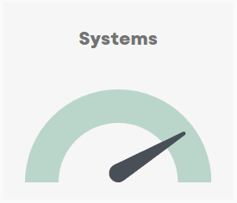
Textile

Slide 35
Textile
Textile in the circular economy
Textile production has increasingly been outsourced to countries with cheap labor since the 1980s. This meant that production capabilities disappeared in Denmark, but at the same time, it led to lower prices for consumers and the beginning of fast fashion. Clothing prices in the EU between 1996 and 2018 decreased by over 30% compared to inflation. Likewise, global textile production nearly doubled between 2000 and 2015. This trend is expected to continue.
The consumption of clothing and footwear is projected to increase by 63% by 2030, from 62 million tons in 2023 to 102 million tons in 2030. Despite increased awareness of sustainability, several brands believe that there still isn't enough economic incentive to operate within the circular economy. In other words, it is still a challenge to deviate from fast fashion and expect acceptable profits through circular business models.
Drivers for a possible market
Within the EU the CE regulation is a strong driver for opportunities. The implementation of the EU directives on Ecodesign for Sustainable Products Regulation, Green Claims, and Extended Producer Responsibility on textiles creates a demand for new solutions and a possible market for Danish companies. E.g. through eco-design for products (such as textile durability, reparability, and recyclability), truthful environmental advertising, and responsible waste management in the textile sector.
On international markets, the effects of the new EU requirements are expected to trickle down in various forms. Particularly, garment producers exporting to the EU market will need to comply with EU requirements e.g. documentation for environmental performance. In developing countries, most textile waste ends up in landfills. This can partly be attributed to the lack of recycling technologies for textile waste. At least we are now witnessing a global development of recycling technologies that in the coming decade will be common in waste management.
Characteristics of the Danish Textile Industry
Denmark is deeply integrated in global value chains. While production has been outsourced, brands have kept their eye on design. Several factors should be noted by Denmark's textile industry:
Circular Innovation: Denmark is at the forefront of various pilot projects exploring circular business models. The innovation is particularly supported by national institutions like universities where experiments and design thinking flourish.
International credibility: Denmark enjoys a robust international reputation, particularly in terms of traceability, a facet that can be further reinforced through the integration of blockchain technology. This becomes increasingly pertinent due to forthcoming EU regulations that demand more traceability and transparency.

Slide 36
Knowledge
Technology
Systems
Design
Danish design has historically excelled in various fields, including furniture design, architecture, textiles, and graphic design. Characteristics of Danish design include simplicity, high quality, and craftsmanship.
Entrepreneurship
The Danish fashion and textile industry is known for its creativity and innovation. Entrepreneurship in this sector includes the use of design thinking, where strategic and practical procedures are employed by designers in the design process to achieve innovative solutions.
Textiles for Furniture Fabrics, Carpets and Workwear
These companies are distinguished by their high-level commitment to sustainability and circularity. Having their own production facilities, they possess a deep understanding of resource optimization. Their control over production allows for a higher degree of experimentation and refinement in their processes.
Life Cycle Assessment
Some Danish consulting firms have specialized in making Life Cycle Assessment (LCA). One consultant is developing user-friendly Life Cycle Assessment (LCA) tool that can be used within the reporting regime that the EU is establishing during these years. There is already demand for this service, and it is expected to grow.
Sorting and Recycling
Automatic sorting as well as industrial recycling are still in early stages in Denmark. However, through national funding in R&D and entrepreneurship, industrial facilities for sorting and recycling is to be expected in coming years.
Online Resale
Several Danish companies engage in online clothing resale instead of operating physical stores. Other companies provide support with logistics and infrastructure, allowing brands to implement take-back programs and resell their products on their own platforms.
Laundries
In Denmark, the Product-as-a-Service model is an established business model for garments in hospitals, restaurants, industry, and more. Laundries have streamlined circular business models for many years, particularly facilitated by high-quality workwear and the use of chips that track the lifecycle of clothing to optimize logistics, deliveries, and maintenance.
Reuse by NGOs
For decades, NGOs have perfected reuse systems. Post-consumer textile is collected, sorted, and resold in physical shops across the country.

Slide 37
Knowledge
Technology
Systems
Design & Entrepreneurship
GANNI
Elemental Colouring
Rodinia Generation
Real Relief
Etc.
Textiles for furniture fabrics and carpets
Kvadrat
Gabriel
Ege Carpets
Dansk Wilton
Workwear
Engel
Borch
NYBO
Mascot
Kentaur
Life Cycle Assessment
Målbar
Sorting
Newretex
Trasborg
UFF Humana
Ragnsells
Remondis
Recycling
Textile Change
Convert
Hviid Hviid
Haack Recycling
Online Resale
Create2Stay
Continued
Less Fashion
Vinted
Secondtots
Tise
Reshopper
Laundries
Textilia
ELIS
Reuse by NGOs
Red Cross
UFF Humana
Danmission
Frelsens Hær
Blå Kors

Slide 38
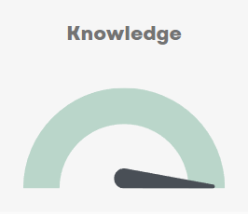
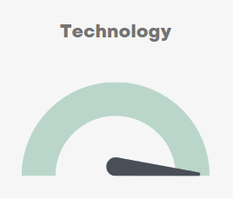
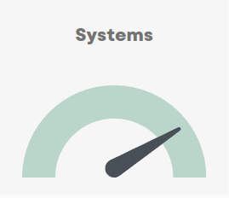
Organic Waste

Slide 39
Organic Waste
Organic Waste within the Circular Economy
Due to the long-standing tradition of large scale pig production in Denmark (10-11 mio. 2023), we have used the manure for biogas production for decades. Thus, Denmark produces 15 PJ of biogas per year based on agricultural side streams and residual products. In 2022, the Danish biogas plants supplied more than 800 million cubic meters of biogas, partly via the gas network, partly directly to cogeneration plants and companies. Biogas thus covered up to approx. 40 percent of the total gas consumption.
This resulted in a greenhouse gas reduction of 1.5 million tons of CO2. The development of the biogas sector has been going on for a long time and is generally an innovative sector. In order to obtain the highest possible yield from the raw materials in the biogas sector, a number of potentials and profitable mixes of both manure and carbon sources have been researched. It is therefore a natural development in the biogas sector that we utilize our organic household waste for biogas production and as a carbon source for the biogas extraction process.
Drivers for a possible market
European countries have been working with organic waste for decades. However, the sector still aims at becoming more efficient by, for instance, improving the utilization of the organic waste for biogas production and advancing the segregation of organic waste, for climate reasons and to promote circularity.
In low- and middle-income countries, organic waste accounts for more than half of all municipal solid waste, but are seldom separated and utilized. Opportunities to segregate organic waste as well as e.g. plastics are often close to commercial, but requires legal frameworks and clarity on financing.
Characteristics of management of organic waste in Denmark
Limited Use of Composting: Denmark uses composting techniques sparingly and primarily for garden waste. Food waste is typically not composted, indicating a preference for other waste management techniques.
Biogas Production: One of the leading techniques for organic waste management in Denmark is the production of biogas. The digestate from this process is then utilized as a fertilizer, effectively recycling the waste product.
Strict Regulations: Denmark has a high level of regulations concerning waste management. These regulations ensure the proper handling and disposal of waste, minimising environmental impact and promoting sustainability.

Slide 40
Knowledge
Technology
Systems
Waste Management
Denmark possesses significant expertise in the efficient management of organic waste. This includes in-depth knowledge of transforming organic waste into biogas, and a continuous focus on innovation to enhance sustainability. The country's unique approach minimizes composting and maximizes the use of waste materials, reflecting a deep understanding of the circular economy principles.
Pre-treatment
Denmark is world leading on pre-treatment of food waste collected in plastic bags from households and industrial organic waste with packaging. The pre-treatment secure the organic material for biogas production and fertilizers mainly trough pulping and filtration.
Biogas
Denmark is world leading on biogas production on manure, straw, food waste industrial waste etc. While it may not be possible on all markets, the Danish production of biogas is loaded into the national gas grid thus contributing to the national supply.
Value Chain
In Denmark, the agricultural sector form industrial symbioses where farms send their organic waste to nearby biogas facilities and in return receives manure for their crops. Municipalities have for decades collected organic waste at households which has also been fed into the bioeconomy.
These companies provide technology for full utilization of all kinds of residuals from the organic value chain. The products varies from fertilizers, compost materials and biochar to biogas and materials for the bioeconomy.

Slide 41
Knowledge
Technology
Systems
Waste Management
NC Miljø
KomTek Miljø
Grainit
Q2
AquaGreen
HedeDanmark
Pre-treatment
Gemidan Ecogi
Bigadan
Biobag Zenzo
Biogas
Landia
Combigas
Renew Energy
Maabjerg Energy Concept
Xergi
Nature Energy
Ammongas
Solum
Value Chain
Solum
Air Liquide Danmark
AquaGreen
Cir-Tech
Daka Denmark
BioCover
Biofos

Slide 42
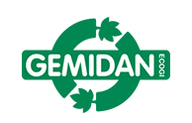
Case – Gemidan Ecogi
Business Case
Provider of pre-treatment technology for food waste from households, retail sector and food industry, including any packaging for private company nearby Warszawa.
Objective
To showcase a robust and efficient technology for pre-treatment of a mixed waste fraction of food waste, including any packaging and collection bags, for biogas and fertilizer production.
Situation
Private company for pre-treatment of organic waste nearby Warszawa, in Poland. The plant is made for homogenization of food waste from households to increase the possibilities for recycling of materials for biogas production and fertilizer uses. The plant has a capacity of min 60.000 tonnes/year.
Solution
Ecogi is designed to treat all types of source separated food based wastes including any packaging. Tests carried out at commercial scale facilities have demonstrated that Ecogi can effectively treat food waste with high levels of physical impurities (up to about 20%) and deliver a high quality pulp for biogas production with an amount of impurities way below the thresholds value.
Benefits
Environmental Impact: By ensuring the recycling of organic material combined with biogas and fertilizer production, it is possible to reduce CO2 emissions from the waste sector.
Economic Efficiency: The Ecogi technology secures a valuable product from food waste for further biogas production and serves as a high quality fertilizer. The products therefore supports parts of the value chain in the market and gas for various energy production.
Recycling of nutrients and carbon: The use of the clean digestate as fertilizer brings back, carbon, nitrogen, phosphorus etc.
Production of energy: The biogas production has potential for big scale and serves as an important contribution to the energy supply.
Investment
The investment required would be the cost of the equipment and all connected facilities to receive, treat, store (huge tank) and deliver the food waste as pulp for biogas production, including costs related to planning, construction, and ongoing support. These plants are normally constructed in connection with other waste transfer or treatment facilities to secure synergies.
Return on Investment
The return on investment is seen in the environmental benefits of reduced amounts of food waste and lower CO2 emissions and the economic benefits of resource substitution and energy production.

Slide 43
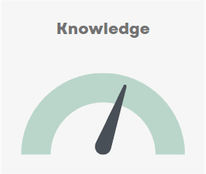

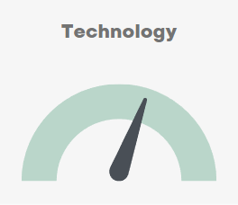
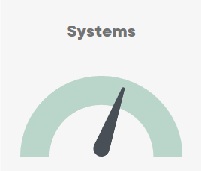
Digitalization

Slide 44
Digitalisation
Digitalisation: A Catalyst for Circular Economy
Digitalisation is a powerful catalyst within the circular economy, enabling the seamless flow of product information, enhancing the integration of value chains, and facilitating the development of circular systems. This digital transformation transcends traditional production and consumption boundaries, influencing waste management systems, resource allocation, and societal behaviours.
Denmark, with its high digital maturity, is spearheading this paradigm shift. Through the deployment of innovative digital tools, the application of intelligent data management systems, and the formulation of visionary digital strategies, Denmark is transitioning from a linear "take-make-waste" model to a more circular "reduce-reuse-recycle" model. This digitalisation not only minimises environmental impact but also generates new opportunities in the global circular economy.
Drivers for a possible market
Within the EU digitalisation is integrated into all the EU regulations on circular economy and waste management, creating a strong demand for digital solutions that can ease the implementation of environmental requirements of the EU. This include data management, life cycle assessment and digital product passport.
International markets for digital solutions on CE and waste is very much depending on the general level of digitalisation in the country. Often the opportunities for digitalisation are running ahead of the political will to react on waste and resource recycling.
Key Aspects of Danish Digitalisation in Circular Economy
Denmark is one of the most digitalised countries in the world, ranking at the top in the Digital Economy and Society Index. The country's digital prowess is evident across various sectors, from public services to the private sector.
Digital Integration: Several Danish firms are leaders in integrating digital solutions within their operations. These integrations significantly enhance systems efficiency and resource optimisation.
Data Management: The industry is highly conscious of data usage, striving to maximise its potential and optimise digital resources. This is reflected in the implementation of advanced data management systems.
Forward-thinking Strategies: Denmark's continuous implementation of progressive digitalisation strategies leads to a highly digitalised society, promoting the seamless flow of information.
Regulatory Compliance: Danish digital companies are responsive to EU's digital regulations, demonstrating their commitment to sustainability and adherence to international standards.

Slide 45
Knowledge
Technology
Systems
Accustomed to the digital
In Denmark, firms are accustomed to operating within highly digitalised systems, a practice that significantly benefits the circular economy. This digital proficiency, coupled with Denmark's high ranking in the Digital Economy and Society Index, facilitates efficient data management, seamless information flow, and innovative digital solutions
Data analysis
Advanced analytics are used to transform complex waste data into practical insights in Denmark's circular economy, optimising resource use and enhancing waste management practices. Additionally, predictive models are developed to help forecast waste generation patterns, enabling proactive planning and decision-making for a more sustainable future.
Digital tools
Danish firms have developed a variety of digital tools to support the circular economy. These include creating intelligent software systems that can manage complex tasks for public services; digital solutions for waste management, including software for tracking waste collection and disposal, and systems for managing recycling processes; and development of digital platforms that facilitates reuse operations.
Deposit system
The Danish deposit system is acclaimed for its effectiveness in promoting a circular economy, which means that resources are reused and recycled to the greatest extent possible. The system achieved a return rate of 92% in 2022, a figure that's among the highest in the world. The system's operation costs are offset by the revenue generated from recycling, which has allowed the system to operate with a zero fee for single-use packaging. Moreover, the Danish deposit system is on a path towards becoming 100% circular, an ambition supported by a continued focus on operational efficiency and optimization.

Slide 46
Knowledge
Technology
Systems
Accustomed to the digital
Most Danish firms
Data analysis
Sweco
COWI
Rambøll
Milva
Econet
JHN Processor
Dansk Miljøportal
Twin Transition
Digital tools
cBrain
Poul Tarp
AMCS Gruppen
Open Experience
Wastecontrol
Nordsense
Maacks
Circle Bank
Deposit system
Dansk Retursystem

Slide 47

Case - cBrain
Business Case
Exporting Danish Digital Solutions to Support Circular Economy in Kenya
Objective
To implement cBrain's F2 digital solution to support the Extended Producer Responsibility (EPR) system in Kenya.
Situation Analysis
Kenya intend to introduce EPR, requiring companies to pay for the costs of waste management of the products they put on the market. This EPR system requires a robust, scalable, and transparent digital platform to manage the process efficiently and effectively. Firstly, there is a need for a producer registry where obligated producers can sign up and register data. Secondly, the authorities need to be able to monitor and audit the producers to ensure compliance.
Solution
cBrain's F2 digital solution, a proven digital platform for public sector management in Denmark, provides an ideal solution for managing Kenya's EPR system. The F2 platform offers a comprehensive suite of tools for membership management, monthly reporting and invoicing, and compliance reporting. It allows for the seamless management of the products lifecycle, from manufacturers to recyclers, ensuring that all actors are accountable for their part in the process.
Benefits
Efficiency and Effectiveness: The F2 platform automates and streamlines processes, reducing administrative burden and costs.
Transparency and Accountability: The system ensures that all actors are held accountable for their responsibilities, discouraging free riders and promoting fair practices.
Scalability and Data Integrity: The F2 platform can handle a large volume of declarations and maintains the confidentiality and integrity of data.
Incentivizing Recycling: By ensuring that all actors pay their dues, the system promotes increased recycling.
Investment
The investment required would be the cost of developing and implementing the F2 platform in Kenya, including customization costs, training, and ongoing support.
Return on Investment
The return on investment would be seen in a well-functioning system to support the Kenya's EPR system in ensuring compliance, the promotion of recycling and the prevention of mismanaged waste.

